Slide 1


MINI PROJECT
ADHIPARASAKTHI ENGINEERING COLLEGE
DESIGN & DEVELOPMENT OF METAL DETECTING
ROBOTIC VEHICLE.
TEAM MEMBERS
TEAM MMBERS
VIGNESHKUMAR D(420420104058)
CHANDRASEKARAN S(420420104301)
HEMKUMAR V(420420104306)
MENTOR
MENTOR
SRINIVASAN G,M.E
Assistant Professor/CSE,APEC

Slide 2
AGENDA
Problem statement
Literature Survey
Proposed System
Hardware Component
Architecture
Modules
Process execution
Advantages
Conclusion
Future Scope

Slide 3
PROBLEM STATEMENT
To Design and develop a metal detecting robotic vehicle capable of autonomously detecting and identifying buried metallic objects in various types of terrain, including soil, sand, and gravel.
The robotic vehicle should be equipped with a reliable metal detection sensor, an efficient power source, and a user-friendly interface for controlling and monitoring its movements and detection results.
The system should be able to detect and differentiate between various types of metals, such as iron, aluminum, and gold, and accurately display their location and depth on a digital map.

Slide 4
LITERATURE SURVEY
S.NO | TITLE | AUTHOR | YEAR | DRAWBACK
1. | MINI DETECTING ROBOT WITH MULTI SENSORS CONTROLLED USING HC-12 MODULE | JEBASINGHKIRUBAKRAN.SJ,ANISHKUMAR, SADAMBI POORNACHANDRAN PRAKASH | 2021 | Limited range: HC-12 modules typically have a range of up to 1 kilometer.
2. | METAL DETECTING ROBOTIC VEHICLE | Dr. SUJATHA B, ARUNA.Y, RAGHAVENDRA.S | 2021 | Metal detecting technology is not always 100% accurate and may produce false readings or miss detecting certain metals.
3. | DESIGN METAL DETECTING ARDUINO REMOTE CONTROL ROBOT VEHICLE CONTROLLED VIA BLUETOOTH | JEYAGOPI.R, CHAN C.K | 2022 | Precise programming needed (time, training)
4. | BLUETOOTH CONTROLLED METAL DETECTOR ROBOT | ANANYA BHATTACHARYYA | 2018 | Bluetooth typically has a range of up to 10 meters,
5. | METAL AND GAS DETECTING ROBOT USING IOT | Ms. SUDHA MERCY S.CHARISMA S.LEKSHMANAN | 2019 | New products require complete reprogramming.

Slide 5
PROPOSED SYSTEM
Detecting and identifying metallic objects: The primary objective of the metal detecting robotic vehicle is to accurately detect and identify metallic objects buried in various types of terrain.
2.Enabling remote operation: The system should be able to be controlled and monitored remotely, allowing users to operate it from a safe distance.
3.Providing a user-friendly interface: The system should have a user-friendly interface that allows users to easily control and monitor the vehicle's movements and detection results.

Slide 6
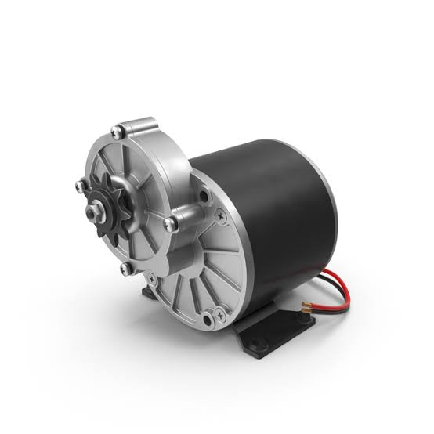
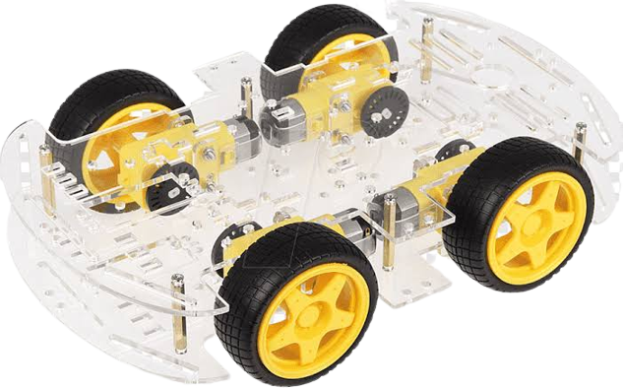
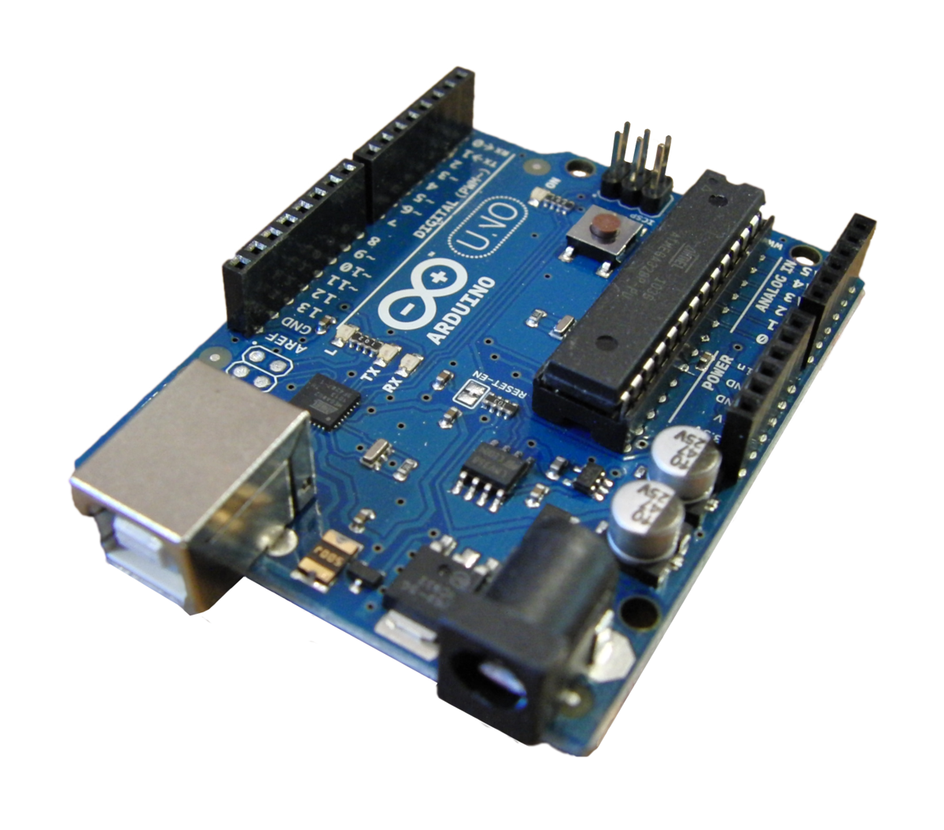
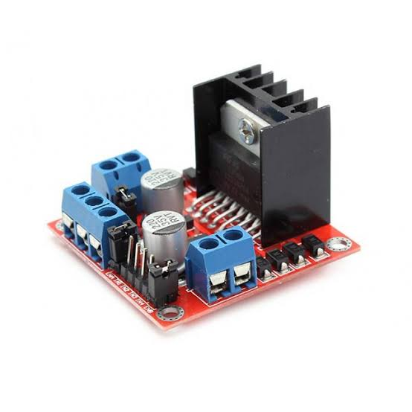
HARDWARE COMPONENT
Arduino board
DC motors
Chassis
Motor driver

Slide 7
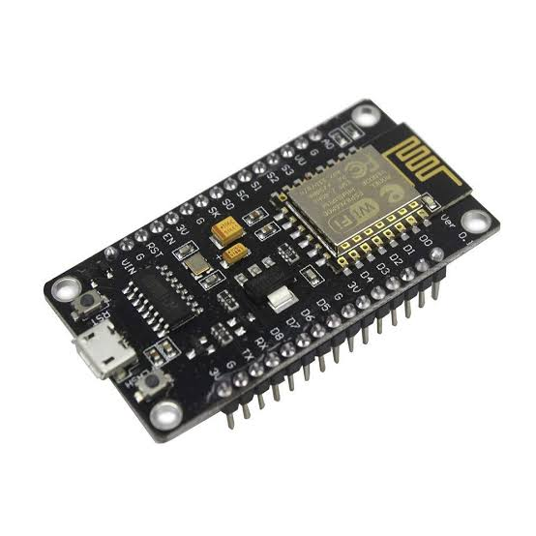
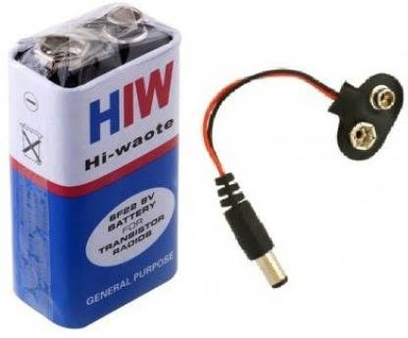
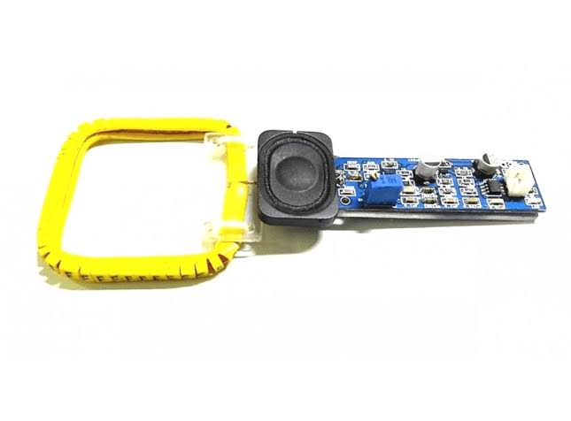
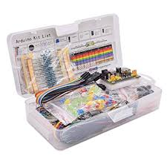
ESP8266 WiFi Module
Battery
Metal detector sensor
Other miscellaneous components (wires, resistors, capacitors, etc.)

Slide 8
ARCHITECTURE
FLOWCHART
FLOWCHART:
START
MOVE FORWARD
METAL DETECTING SENSOR
BUZZER
MOVE FORWARD
STOP
Fig: Proposed Design Flowchart

Slide 9
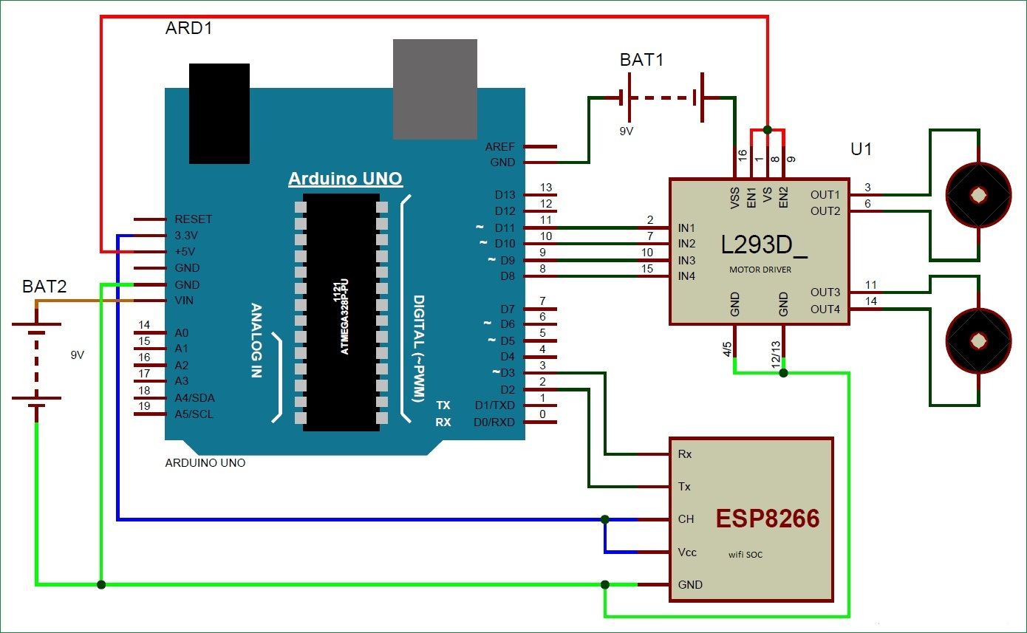
Figure 1. Circuit of metal detecting robot

Slide 10
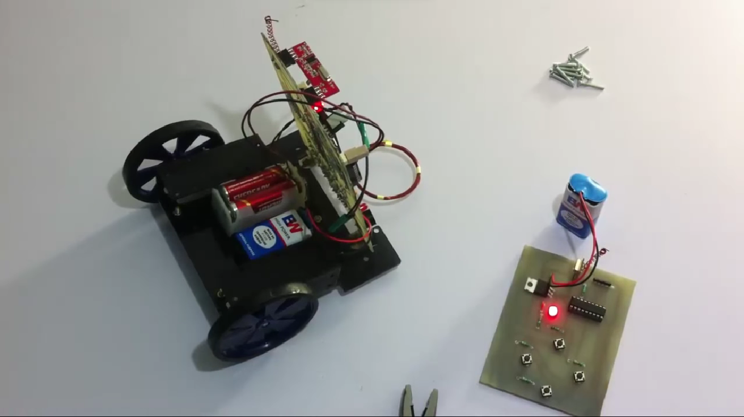
MODULE
Module 1:
We studied about the design of metal detecting robotic vehicle and with the help of literature survey we gained knowledge about the
previous projects.

Slide 11
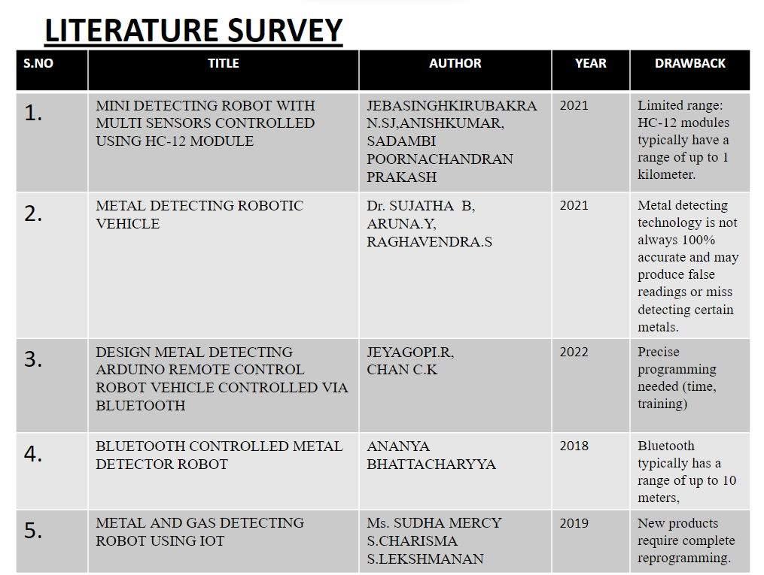
MODULE 2:
By studying the literature survey of previously done projects on metal detecting robotic vehicle over the years, we came to know about the demerits & drawbacks of those existing projects.

Slide 12
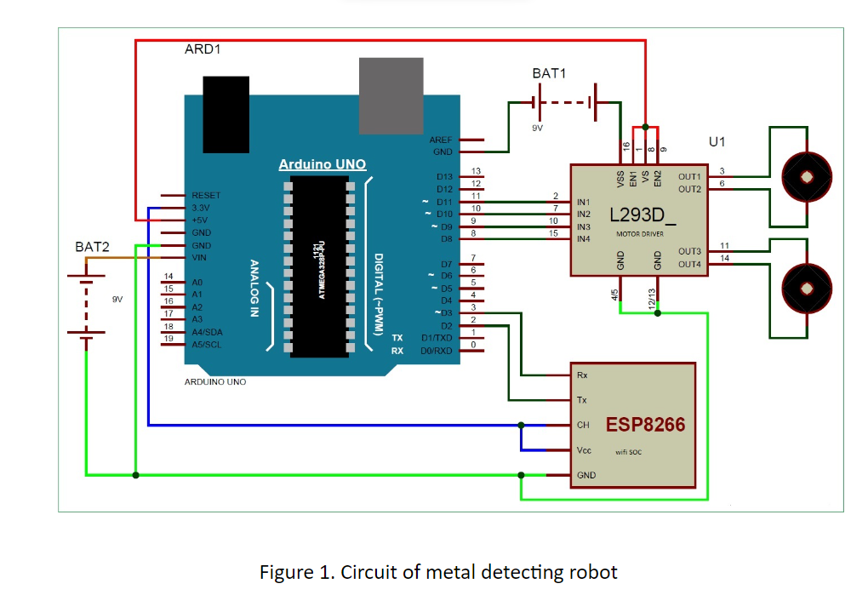
MODULE 3:
From the requirements and specification we develope the architectural model with the help of circut diagram.

Slide 13
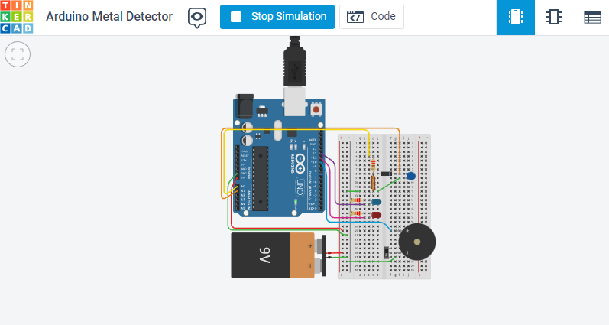
MODULE 4:
With the help of circuit diagram we constructed the metal detecting robotic vechicle with specified components.

Slide 14
PROCESS EXECUTION:
const byte npulse = 01;
const bool sound = true;
const bool debug = true;
const byte pin_pulse=A0;
const byte pin_cap =A1;
const byte pin_LED1 =12;
const byte pin_LED2 =11;
const byte pin_tone =10;
void setup() {
if (debug) Serial.begin(9600);
pinMode(pin_pulse, OUTPUT);
digitalWrite(pin_pulse, LOW);
pinMode(pin_cap, INPUT);
pinMode(pin_LED1, OUTPUT);
digitalWrite(pin_LED1, LOW);
pinMode(pin_LED2, OUTPUT);
digitalWrite(pin_LED2, LOW);
if(sound)pinMode(pin_tone, OUTPUT);
if(sound)digitalWrite(pin_tone, LOW);
}
const int nmeas=256; //measurements to take
long int sumsum=0; //running sum of 64 sums
long int skip=0; //number of skipped sums
long int diff=0; //difference between sum and avgsum
long int flash_period=0;//period (in ms)
long unsigned int prev_flash=0; //time stamp of previous flash

Slide 15
ADVANTAGES:
A robotic vehicle can cover large areas of land much faster than a human operator, increasing the efficiency of metal detecting operations.
Robotic vehicles can be equipped with advanced sensors and imaging technologies that can detect even small metal objects with high precision.
Robotic vehicles are not affected by fatigue, distraction, or bias, which can affect human operators, resulting in more consistent and accurate metal detection results.
Robotic vehicles can make metal detecting more accessible to people with disabilities or other physical limitations.

Slide 16
CONCLUSION
The metal detecting robotic vehile acuretly detect metallic object which buried in various types of terrain
The vehicle navigate an manually around obstacles and uneven terrain while maintain stable detection perfomance

Slide 17
FUTURE SCOPE
Enabling remote operation: The system should be able to be controlled and monitored remotely, allowing users to operate it from a safe distance.
Providing a user-friendly interface: The system should have a user-friendly interface that allows users to easily control and monitor the vehicle's movements and detection results.

Slide 18
THANK YOU

